Slide 1
Figures – Chapter 16

Slide 2
Figure 16.1 Benefits of software reuse
Benefit | Explanation
Increased dependability | Reused software, which has been tried and tested in working systems, should be more dependable than new software. Its design and implementation faults should have been found and fixed.
Reduced process risk | The cost of existing software is already known, whereas the costs of development are always a matter of judgment. This is an important factor for project management because it reduces the margin of error in project cost estimation. This is particularly true when relatively large software components such as subsystems are reused.
Effective use of specialists | Instead of doing the same work over and over again, application specialists can develop reusable software that encapsulates their knowledge.
Standards compliance | Some standards, such as user interface standards, can be implemented as a set of reusable components. For example, if menus in a user interface are implemented using reusable components, all applications present the same menu formats to users. The use of standard user interfaces improves dependability because users make fewer mistakes when presented with a familiar interface.
Accelerated development | Bringing a system to market as early as possible is often more important than overall development costs. Reusing software can speed up system production because both development and validation time may be reduced.

Slide 3
Figure 16.2 Problems with reuse
Problem | Explanation
Increased maintenance costs | If the source code of a reused software system or component is not available then maintenance costs may be higher because the reused elements of the system may become increasingly incompatible with system changes.
Lack of tool support | Some software tools do not support development with reuse. It may be difficult or impossible to integrate these tools with a component library system. The software process assumed by these tools may not take reuse into account. This is particularly true for tools that support embedded systems engineering, less so for object-oriented development tools.
Not-invented-here syndrome | Some software engineers prefer to rewrite components because they believe they can improve on them. This is partly to do with trust and partly to do with the fact that writing original software is seen as more challenging than reusing other people’s software.
Creating, maintaining, and using a component library | Populating a reusable component library and ensuring the software developers can use this library can be expensive. Development processes have to be adapted to ensure that the library is used.
Finding, understanding, and adapting reusable components | Software components have to be discovered in a library, understood and, sometimes, adapted to work in a new environment. Engineers must be reasonably confident of finding a component in the library before they include a component search as part of their normal development process.

Slide 4
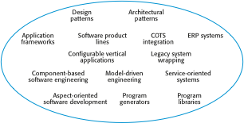
Figure 16.3 The reuse landscape

Slide 5
Figure 16.4 Approaches that support software reuse
Approach | Description
Architectural patterns | Standard software architectures that support common types of application systems are used as the basis of applications. Described in Chapters 6, 13, and 20.
Design patterns | Generic abstractions that occur across applications are represented as design patterns showing abstract and concrete objects and interactions. Described in Chapter 7.
Component-based development | Systems are developed by integrating components (collections of objects) that conform to component-model standards. Described in Chapter 17.
Application frameworks | Collections of abstract and concrete classes are adapted and extended to create application systems.
Legacy system wrapping | Legacy systems (see Chapter 9) are ‘wrapped’ by defining a set of interfaces and providing access to these legacy systems through these interfaces.
Service-oriented systems | Systems are developed by linking shared services, which may be externally provided. Described in Chapter 19.
Software product lines | An application type is generalized around a common architecture so that it can be adapted for different customers.
COTS product reuse | Systems are developed by configuring and integrating existing application systems.
ERP systems | Large-scale systems that encapsulate generic business functionality and rules are configured for an organization.
Configurable vertical applications | Generic systems are designed so that they can be configured to the needs of specific system customers.
Program libraries | Class and function libraries that implement commonly used abstractions are available for reuse.
Model-driven engineering | Software is represented as domain models and implementation independent models and code is generated from these models. Described in Chapter 5.
Program generators | A generator system embeds knowledge of a type of application and is used to generate systems in that domain from a user-supplied system model.
Aspect-oriented software development | Shared components are woven into an application at different places when the program is compiled. Described in Chapter 21.

Slide 6
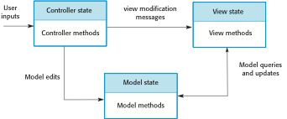
Figure 16.5 The Model-View-Controller pattern

Slide 7
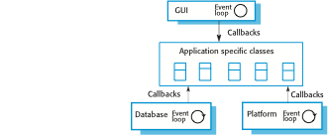
Figure 16.6 Inversion of control in frameworks

Slide 8
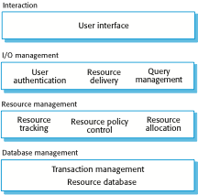
Figure 16.7 The architecture of a resource allocation system

Slide 9
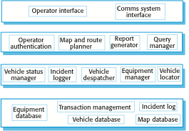
Figure 16.8 The product line architecture of a vehicle dIspatcher system

Slide 10

Figure 16.9 Product instance development

Slide 11
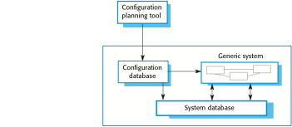
Figure 16.10 Deployment-time configuration

Slide 12
Figure 16.11 COTS-solution and COTS-integrated systems
COTS-solution systems | COTS-integrated systems
Single product that provides the functionality required by a customer | Several heterogeneous system products are integrated to provide customized functionality
Based around a generic solution and standardized processes | Flexible solutions may be developed for customer processes
Development focus is on system configuration | Development focus is on system integration
System vendor is responsible for maintenance | System owner is responsible for maintenance
System vendor provides the platform for the system | System owner provides the platform for the system

Slide 13
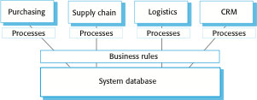
Figure 16.12 The architecture of an ERP system

Slide 14
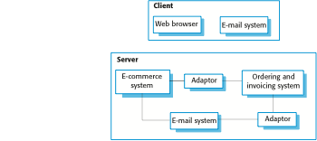
Figure 16.13 A COTS-integrated procurement system

Slide 15
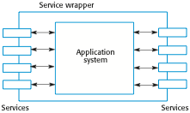
Figure 16.14 Application wrapping

